Slide 1
Self Portraits
A study of shadows

Slide 2
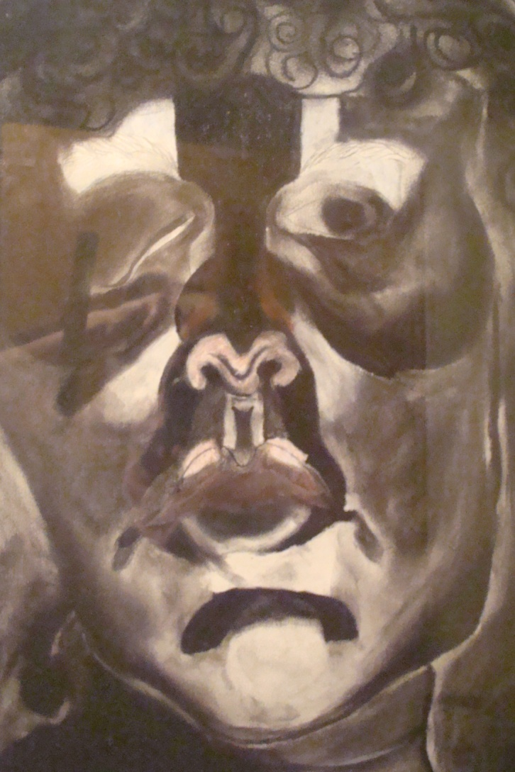
My charcoal self portrait

Slide 3
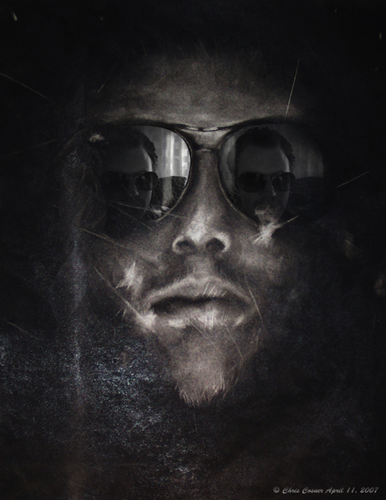
What do you like about this one?

Slide 4
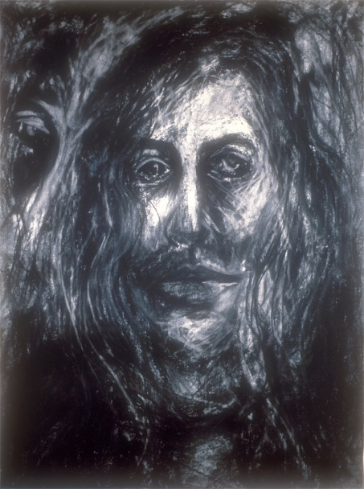
This one??

Slide 5
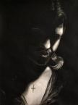
What is effective in this one?

Slide 6
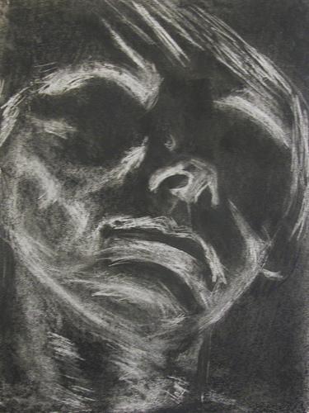
What works here?

Slide 7
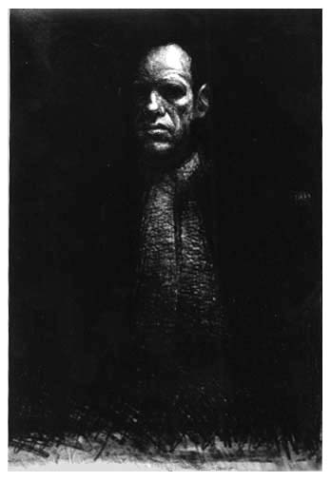
…and this one?

Slide 8
Grab a flashlight
Pick a partner…
Have your partner hold the flashlight under their chin casting shadows. You may have to direct them where to move the light to cast better shadows.
Sketch your partner with charcoal. This is a gesture drawing…no real detail needed.

Slide 9
For tomorrow
Decide on accessories…sunglasses, necklace, a hat…specific symbolic images you want to evoke in your self portrait.
Be prepared to have your photo taken!
We’ll print the photos off in black and white.
You will begin your charcoal self portrait using your photo as a reference.

